Slide 1
Signiﬁcant Permission Identiﬁcation for Machine-Learning-Based Android Malware Detection
Authors: Jin Li*, Lichao Sun@, Qiben Yan#, Zhiqiang Li#, Witawas Srisa-an#, and Heng Ye^
(* Guangzhou University, @ University of
Illinois at Chicago, # University of Nebraska–Lincoln, ^Beijing Jiaotong University)
From: IEEE TRANSACTIONS ON INDUSTRIAL INFORMATICS, VOL. 14, NO. 7, JULY 2018

Slide 2
Android OS
Android is the most popular operating system for smart-mobile devices occupying 85% of market share
Android is also widely used in other mobile platforms(such as tablets, smart tvs, and smartwatches, etc)
Year | 2016 | 2017 | 2018 | 2019 | 2020 | 2021 | 2022
Android | 84,6% | 85,1% | 84,8% | 85,2% | 85,3% | 85,4% | 85,5%
iOS | 14,7% | 14,7% | 15,1% | 14,8% | 14,6% | 14,6% | 14,5%
Others | 0,7% | 0,2% | 0,1% | 0,1% | 0,1% | 0,1% | 0,1%
TOTAL | 100,0% | 100,0% | 100,0% | 100,0% | 100,0% | 100,0% | 100,0%
2
IDC, Smartphone Vendor Market Share

Slide 3
Growth of Android Malware
Android allows to install applications from uncertified third party stores
97% of all mobile malware target Android devices
In 2016 alone, over 3.25 million new malicious Android apps have been uncovered. This roughly translates to an introduction of a new malicious Android app every 10s
There is a need to create an effective and efficient malware detection system to cope with this rapid growth of malicious apps.
3

Slide 4
Signiﬁcant Permission IDentiﬁcation (SIGPID)
An approach that extracts signiﬁcant Permissions from apps and uses the extracted information to effectively detect malware using supervised learning
Goal: to detect malware efﬁciently and accurately
Propose a multilevel data pruning (MLDP) approach to extract signiﬁcant permissions that are signiﬁcant in distinguishing between malicious and benign apps
Machine-learning-based classiﬁcation algorithms are used to classify different types of malware and benign apps
4
Notes:
An approach that extracts signiﬁcant Permissions from apps and uses the extracted information to effectively detect malware using supervised learning

Slide 5

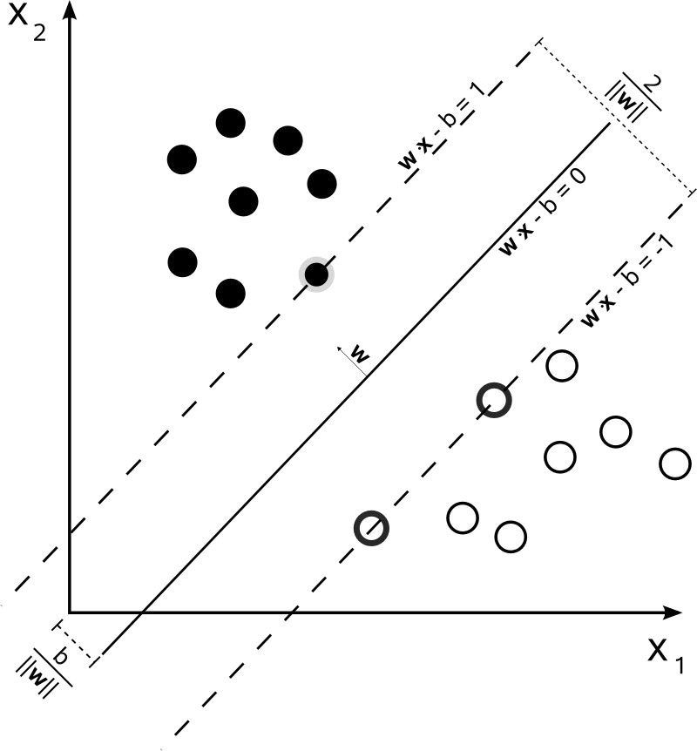
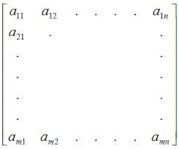




System Overview
2
Support Vector Machines
permission matrix
(an app constructs a vector)
3
benign apps
1
5
Decision Tree
7
Training & Testing
6
Multi-Level Data Pruning
Malware Detection Results
malicious apps
4
Results
new permission matrix (less features after pruning)
Malware Detection System
4
Building Detection System
Data Pre-Processing

Slide 6
Introducing SIGPID
Multi-Level Data Pruning (MLDP)
Malware Detection using Significant Permission
6

Slide 7
Multi-Level Data Pruning (MLDP)
Motivation: 135 permissions + huge number of applications = long processing time
Three levels of data pruning
1
2
3
Permission Ranking With
Negative Rate (PRNR)
Support-Based Permission
Ranking(SPR)
Permission Mining With
Association Rules(PMAR)
7

Slide 8
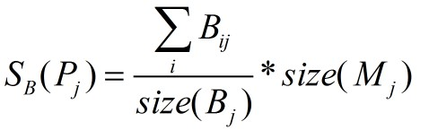
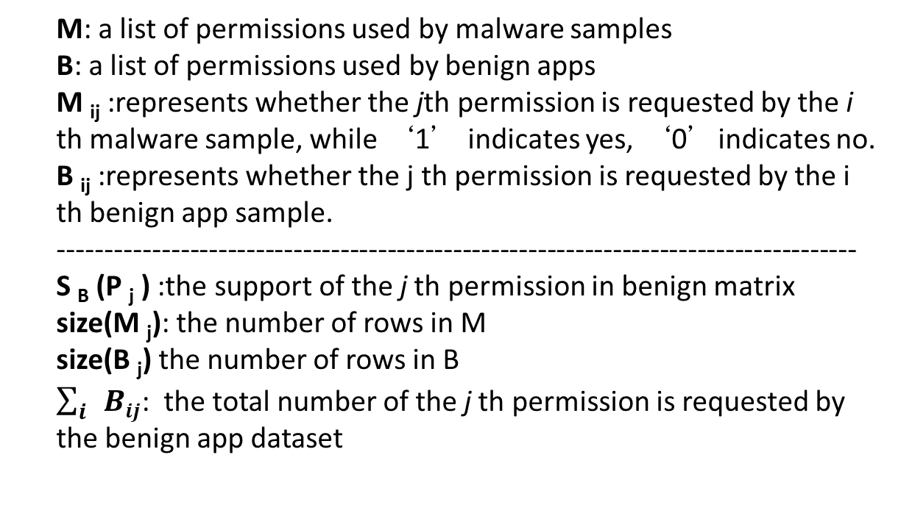
Balance Benign and Malicious Matrixes
The number of benign apps (310,926 in this paper) tends to be much larger than the number of malicious apps (5,494 samples)
Training over imbalanced dataset can lead to skewed models
Two matrixes:
Matrix of original malware: M
Matrix of original benign apps: B
Permission support formalization:
M: a list of permissions used by malware samples
B: a list of permissions used by benign apps
M _{ij} :represents whether the jth permission is requested by the i th malware sample, while ‘1’ indicates yes, ‘0’indicates no.
B _{ij} :represents whether the j th permission is requested by the i th benign app sample.
-------------------------------------------------------------------------------------
S _{B} (P _{j} ) :the support of the j th permission in benign matrix
size(M _{j}): the number of rows in M
size(B _{j}) the number of rows in B
$\sum_{i}{Bij}$: the total number of the j th permission is requested by the benign app dataset
8
Notes:
Skewed models: for example, in the case where the size of matrix M is 10 and the size of matrix B is 1000, after applying supervised machine learning techniques for classiﬁcation, the classiﬁcation models mainly skew towards capturing the characteristics of matrix B, thereby aﬀecting classiﬁcation accuracy.

Slide 9
Permission Ranking with Negative Rate (PRNR)
Within our evaluation
dataset with 5494 benign apps from 310 926, the total number
of distinct permissions requested by all the apps is 135. Extract significant permissions:
Highly risky permission requested by malware
Rarely touched permission by malware
Remove permissions equally used by benign and malicious applications
9

Slide 10
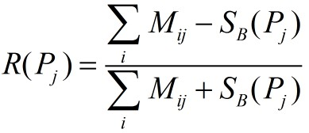
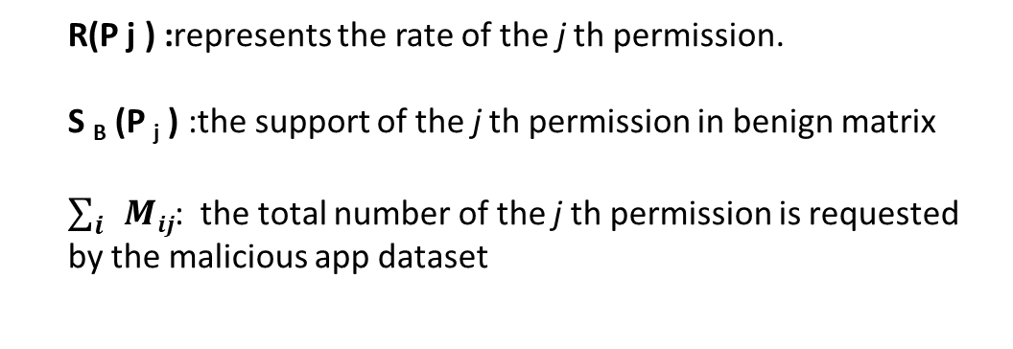
Permission Ranking with Negative Rate (PRNR)
R(P_{i}) = [-1,1]
-1 means non-risky permission
1 means risky permission
0 means lowest impact
Benign ranking list: -1 to 0
Malicious ranking list: 1 to 0
Reduce: near 0
R(P j ) :represents the rate of the j th permission.
S _{B} (P _{j} ) :the support of the j th permission in benign matrix
$\sum_{i}{Mij}$: the total number of the j th permission is requested by the malicious app dataset
10

Slide 11
Permission Incremental System (PIS)
Two sorted permission lists(benign and malicious ranking list) based on PRNR
PIS procedure
Choose the top permissions in benign and malware permission lists and evaluate malware detection
top three permissions in both lists and evaluate malware detection
Repeat until f-measure (2 precision*recall/ precision=recall)becomes stable
Remove 40 insignificant permissions from the total of 135 permissions
Remaining Permission : 135 – 40 = 95 ₁₁

Slide 12
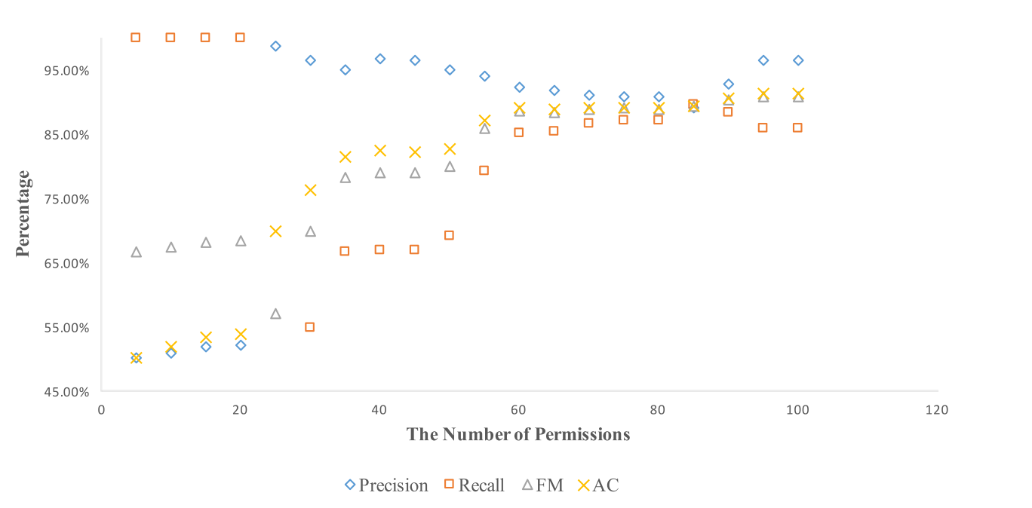
Malware classiﬁcation performance of the PIS with PRNR

Slide 13
Support Based Permission Ranking (SPR)
Prune permissions with low impact
Use PIS to ﬁnd the least number of permissions with high support while yielding good accuracy
Remove 70 more permissions
Remaining Permission: 135 – 40 - 70 = 25

Slide 14
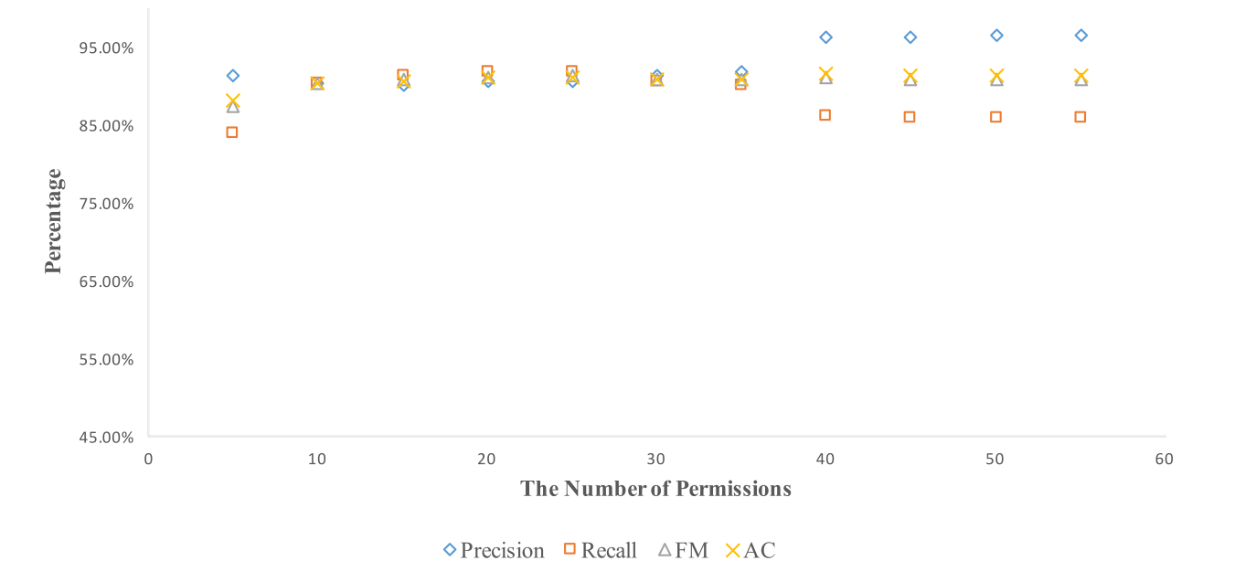
Malware classiﬁcation performance of the PIS with SPR

Slide 15
Permission Mining with Association Rules (PMAR)
Some permissions are always used together
We can use the one with higher support to represent both
Use Apriori with 95% minimum confidence and 3% minimum support
Remove 3 additional permissions
Remaining Permission: 135 – 40 – 70 – 3 = 22

Slide 16
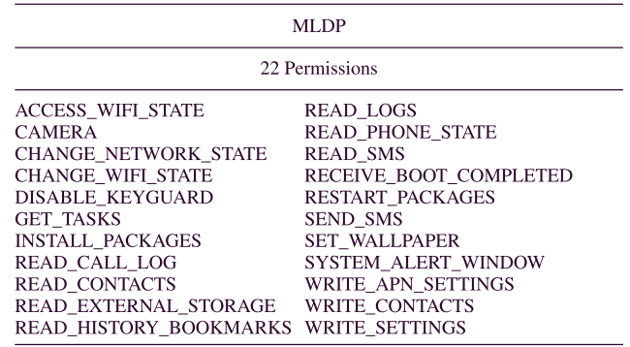
Signiﬁcant Permissions Generated by MLDP

Slide 17
Evaluation
Data Set
MLDP Effectiveness
Malware Detection Performance with Different Machine Learning Algorithms
Comparison with Other Approaches

Slide 18
Evaluation Criterion
Precision
Recall
F-Measure
 |  | prediction
 |  | malicious | benign
actual | malicious | TP | FN
 | benign | FP | TN
200 apps (100 malicious apps + 100 benign apps)
 |  | prediction
 |  | malicious | benign
actual | malicious | 85 | 15
 | benign | 5 | 95
Precision = TP/(TP+FP)=94.4%
Recall = TP/(TP+FN)=85%
FM = 2*Precision*Recall/(Precision+Recall)= 89.7%

Slide 19
Data Set
5,494 malicious applications, 310,926 benign applications, downloaded from Google play store in June 2013
Extract permission information from the Android Manifest file of each app
One vector represent an app with 1s and 0s, where 1 represents required permission and 0 otherwise

Slide 20
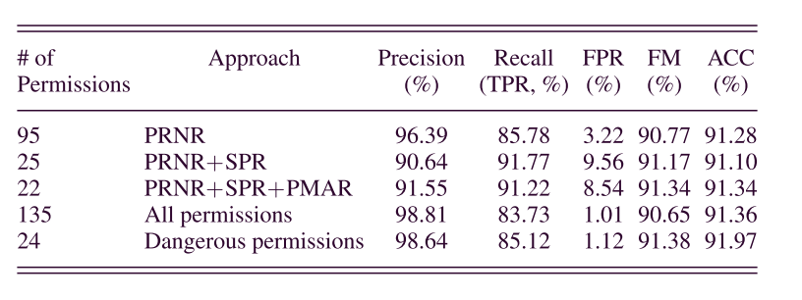
Multi-level Data Pruning Effectiveness(1/2)
*
*Google also identiﬁes 24 permissions out of the total of more than 300 permissions as “dangerous”

Slide 21
Performance of Machine Learning Algorithms(2/2)
MLDP incurs anywhere from 4 times (when rotation forest is used) to 32 times (when FT is used) less processing times than those incurred by an approach that analyzes the complete permission list.
# of Permissions | 22 | 40 |  | 135
Name of Algorithm | Time(Seconds) | Time | More Time | Time | More Time
RandomCommittee | 1.376 | 2.078 | 51.02% | 7.995 | 481.03%
RotationForest | 47.303 | 71.887 | 51.97% | 236.944 | 400.91%
FT | 0.731 | 2.14 | 192.75% | 24.55 | 3258.41%
PART | 16.673 | 24.645 | 47.81% | 104.74 | 528.20%
RandomForest | 14.028 | 20.045 | 42.89% | 59.991 | 327.65%
SVM | 2.4722 | 2.7604 | 11.66% | 3.6773 | 48.75%

Slide 22
Evaluating Generality of MLDP (1/2)
Implement 67 machine learning algorithms
55 out of 67 algorithms can achieve F-measure of at least 85%, while the average running time can be reduced by 85.6% compared with the baseline approach.

Slide 23
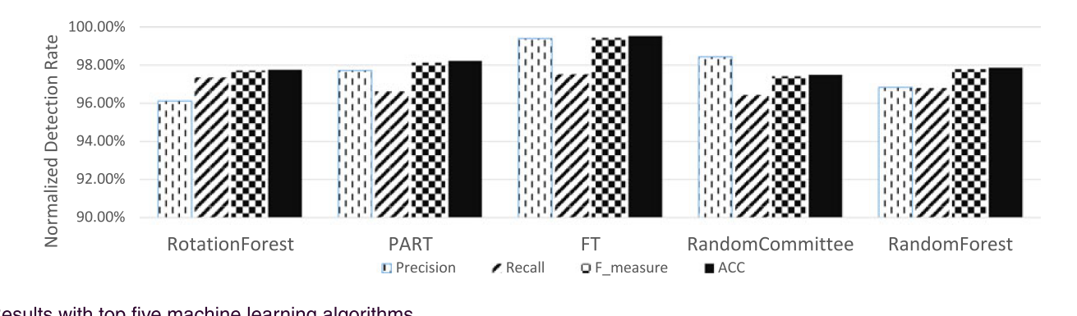
Evaluating Generality of MLDP (2/2)
The top ﬁve malware detection models that achieve above 96% F-measure and above 94% in other performance measures

Slide 24
Optimal ML Algorithms For SigPID and Android Dangerous Permissions
Even with the most optimal algorithms, our approach still yields 3.27% higher recall rate than using the dangerous permission list
#of Permissions | Best ML | Precision | Recall(TPR) | FPR | F-measure | Accuracy
SigPID (22) | FT | 97.54% | 93.62% | 2.36% | 95.54% | 95.63%
Android (24) | Random Forest | 98.61% | 90.35% | 1.27% | 94.30% | 94.54%

Slide 25
Detection Performance using Unknown Real-World Malware
Creating another newer collection of apps in June 2015 containing 2650 new malware samples with no overlap with the initial sets
MLDP(22) detects 4–5.5% more malware than Android(24), achieving up to 91.4% detection rate.
RandomForest
PART
FT
RotationForest
RandomCommittee
83.0%
84.0%
85.0%
86.0%
87.0%
88.0%
89.0%
90.0%
91.0%
92.0%
Android MLDP_22

Slide 26
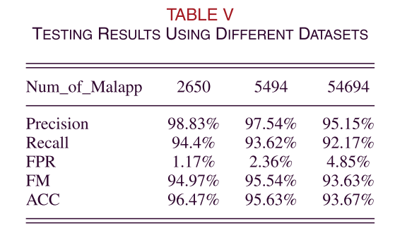
Applicability of SigPID
Collected three different real-world datasets, which contain 2650, 5494 and 54,694 malware apps
SigPID can retain a high detection rate despite that the size of the dataset is
huge

Slide 27
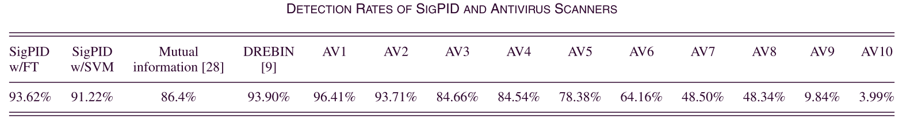
Comparison with other approaches
When we combine SIGPID with FT, SigPID can achieve the highest detection rate (93.62%) using only 22 permissions.

Slide 28
Conclusion
SIGPID can drastically reduce the number of permissions (22 out of 135 ,84% reduction), while maintaining over 90% malware detection accuracy and F-measure when a support vector machine (SVM) is used as the classiﬁer.
Their approach performs as well as or better than techniques that consider more permissions or all permissions
By using significant permissions, they can improve performance a lot

Slide 29

Thank you

Slide 30
Future Work
Enlarge dataset for malware and collect more features of the original dataset
Develop a new machine learning algorithm
Use additional information, such as that obtained through static program structure information (e.g., Static call graphs and calling context) and runtime information (e.g., Dynamic call graphs) to further classify behavior and pinpoint locations of malicious code

